Slide 1
Database security

Slide 2
INTRODUCTION
Database security is the technique that protects and secures the database against intentional or accidental threats.
Database security includes hardware part, software part, human resource, and data.
The breaking of security may harm other parts of the system which may ultimately affect the database structure.
Database security about the following situations:
            • Theft and fraudulent.
            • Loss of confidentiality or secrecy.
            • Loss of data privacy.
            • Loss of data integrity.
            • Loss of availability of data.

Slide 3
What is a Database Security Threat(s)
Any situation or event, whether intentionally or incidentally, which can cause damage to the database, which can reflect an adverse effect on the database structure and consequently the organization.
Any situation or event, whether intentionally or incidentally, which can cause damage to the database, which can reflect an adverse effect on the database structure and consequently the organization.
Threat may occur by a situation involving a person’s actions, machinery failure, power failure, natural disasters, program failure, or by malware.

Slide 4
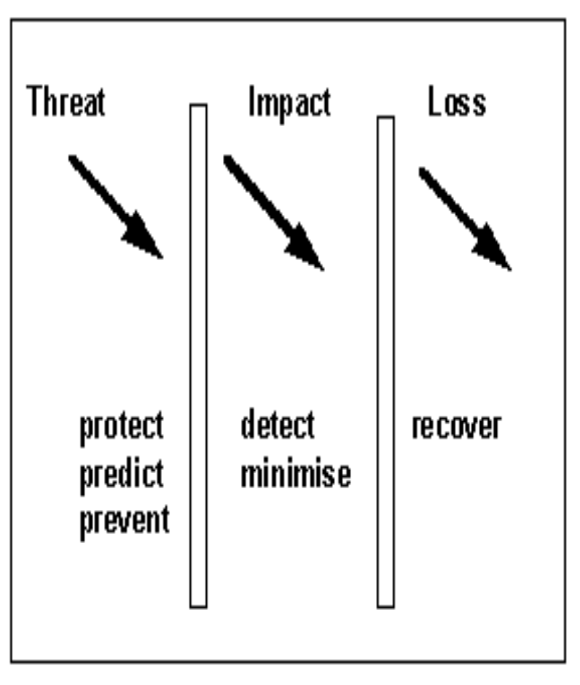
The scope of database security
An outlined development mechanism is:
Document assets (what they are, what their value is).
Identify treats (what they are, how likely they are, what the impact is if
they occur).
Associate threats with each asset, may include: Hardware, Software, Data, Data quality, Credibility, Availability, and other Business benefit.
Design mechanisms to protect each asset appropriate to its value and the
cost of its protection, to detect a security breach against each asset, to minimize the losses incurred and to recover normal operation.

Slide 5
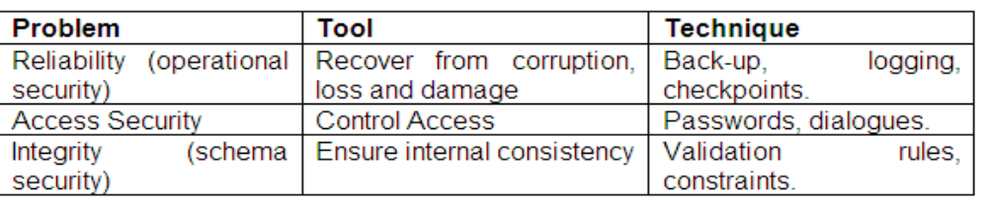
Common Database Security Threats
Unauthorized modification: Changing data values for reasons of sabotage, crime or ignorance
Unauthorized disclosure: When information that should not have been disclosed has been disclosed.
Loss of availability or denial of service:

Slide 6
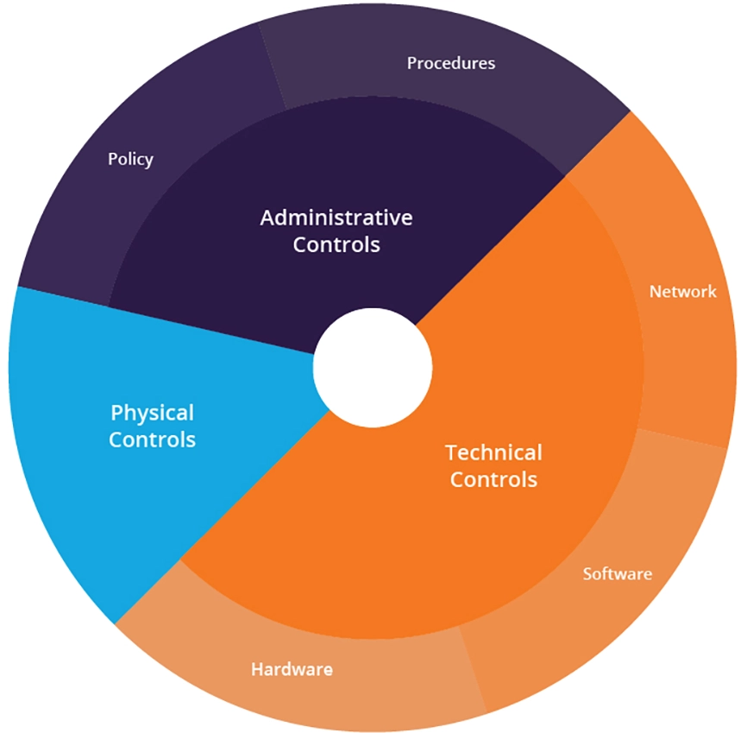
Defencing-Depth Strategy

Slide 7
Defense in depth architecture
Administrative controls— include procedures and policies that restrict permissions and guide users on how to maintain security.
Technical controls— include specialized software and hardware that are used to protect system resources. For example, antivirus or firewall solutions.
Physical controls— include physical infrastructure for protecting systems, such as locked doors and security cameras.
Access measures – include biometrics, virtual private networks (VPNs), authentication controls, and timed access.
Workstation defenses – include anti-spam software or antivirus agents.
Data protection – includes password hashing, encryption, and secure transfer protocols.
Perimeter defenses – include intrusion detection and prevention systems and firewalls.
Monitoring and prevention – include logging, vulnerability scanning, and security training for staff.
Threat intelligence – data feeds providing up-to-date information about indicators of compromise (IoC), known threat actors and their tactics, techniques and procedures (TTP).
Antivirus: This is the tool that stops malicious software from entering the network and spreading.
Behavioral analysis: Algorithms and ML can detect anomalies in the behavior of employees and in the applications and devices themselves.

Slide 8
Computer-Based Controls
Defense in depth is a cybersecurity approach that uses layered defensive mechanisms to protect systems and data. With layering, if one defense fails, another is there to block an attack.
The different forms of countermeasure to threats on computer systems range from physical controls to managerial procedures. Most of the computer-based database security is listed below:
• Access authorization
• Access controls
• Views.
• Backup and recovery of data.
• Data integrity.
• Encryption of data.
• RAID technology.

Slide 9
Access Authentication: The client has to establish the identity of the server and the server has to establish the identity of the client. This is done often by means of shared secrets (either a password/user-id combination, or shared biographic and/or biometric data). It can also be achieved by a system of higher authority which has previously established authentication. In client-server systems where data (not necessarily the database) is distributed, the authentication may be acceptable from a peer system.
Access controls: Discretionary control is where specific privileges are assigned on the basis of specific assets, which authorised users are allowed to use in a particular way. The security DBMS has to construct an access matrix including objects like relations, records, views and operations for each user - each entry separating create, read, insert and update privileges.

Slide 10
Access authorization: Authorisation relates to the permissions granted to an authorised user to carry out particular transactions, and hence to change the state of the database, which can be followed by adding level of authorization to view or manipulate the data.
  Role: A role grants users/applications certain privileges to view, edit, or perform other specified actions within the database. When setting up roles, you should adopt the principle of least-privileges.
  Permissions: Typically, a user’s permissions are assigned to reflect the role they perform.
  Data Encryption: All sensitive data should be encrypted both at-rest and in-flight with robust, standards based encryption.

Slide 11
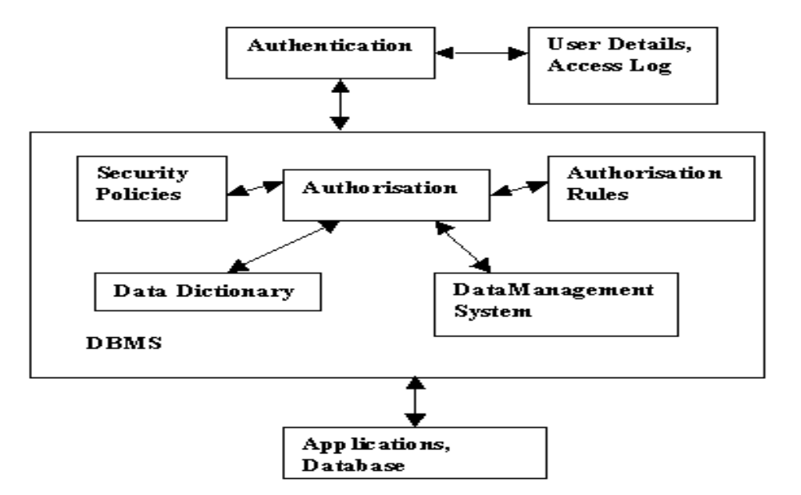

Slide 12
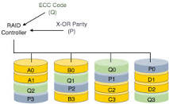
RAID technology
RAID (Redundant Array of Independent Disks), is a technology to connect multiple secondary storage devices and use them as a single storage media. RAID consists of an array of disks in which multiple disks are connected together to achieve different goals.
There are basically 7 levels of RAID schemes. These schemas are as RAID 0, RAID 1, ...., RAID 6.
These levels contain the following characteristics:
It contains a set of physical disk drives.
In this technology, the operating system views these separate disks as a single logical disk.
In this technology, data is distributed across the physical drives of the array.
Redundancy disk capacity is used to store parity information.
In case of disk failure, the parity information can be helped to recover the data.

Slide 13
encryption of data
Database encryption is the process of converting data, within a database, in plain text format into a meaningless cipher text by means of a suitable algorithm. Database decryption is converting the meaningless cipher text into the original information using keys generated by the encryption algorithms.
DATABASE ENCRYPTION LIST OF BEST PRACTICES
          Ensure Physical Database Security.
          Use Web Application and Database Firewalls.
          Harden Your Database to Fullest Extent Possible.
          Encrypt Your Data.
          Minimize Value of Your Database.
          Manage Database Access Tightly.
          Audit and Monitor Database Activity.

Slide 14
Backup and Recovery
Database Management System should offer backup facilities to help with the recovery of a database after a failure.
The backups need to be at the regular period and ensuring that the copies are in a secure location.
In the event of a failure that renders the database unusable, the backup copy and the details captured in the log file are used to restore the database to the latest possible consistent state.

Slide 15
Security plan
Identify the user community.
Gather the database information.
Determine the types of user account (i.e. associate database objects and
user roles).
Undertake a threat analysis.
Establish DBA authorities and procedures.
Establish policies for managing (creating, deleting, auditing) user accounts.
Determine the user tracking policy.
Establish the user identification method.
Define security incidents and reporting procedure.
Assess the sensitivity of specific data objects.
Establish standards and enforcement procedures (as well as back-up and
recovery plans, of course).

